Slide 1
Learning & Development Enabling development, Impacting growth…
Cognos 11 (IBM Cognos Analytics) – Training
Cognos Analytics

Slide 2
Module Objectives :
What is Report, Dashboard and Data Module?
User Interface & Navigation
Objects
Creating a Report
Report Types
Data, toolbox, and navigate areas
Design Vs Preview Vs Structure
On-Demand Property Pane
Visualizations
Repeater Report
Prompts
Report Studio Views
Auto Group and Summarize
Drill-throughs
Master & Details relationship
Conditional Formatting
Working with Queries
Templates
Reuse a Layout Object
Active Report
Data Sets
Data Modeling on web
Dash boarding
Snapshot Dashboard
Notification

Slide 3
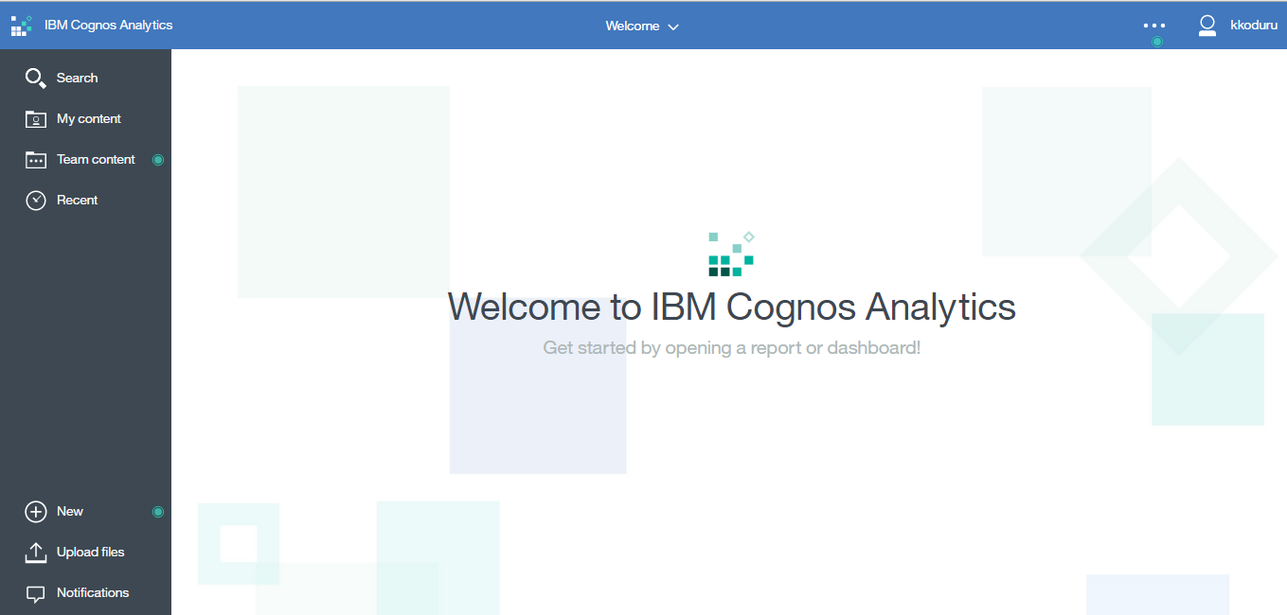
IBM Cognos 10 BI
IBM Cognos Homepage

Slide 4
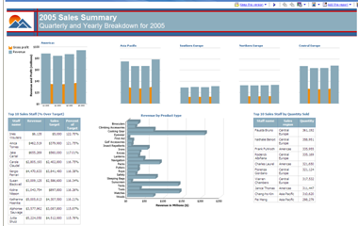
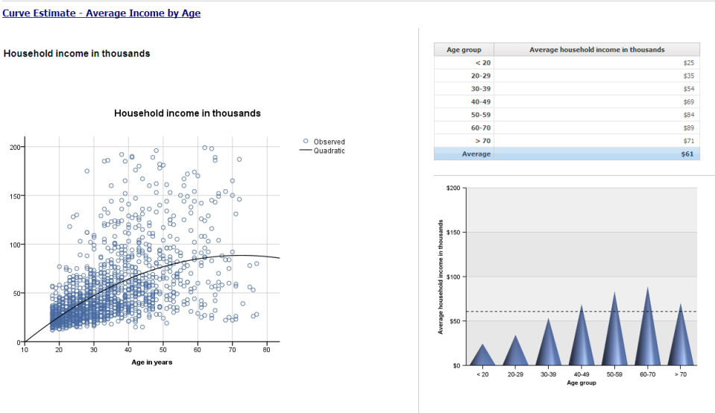
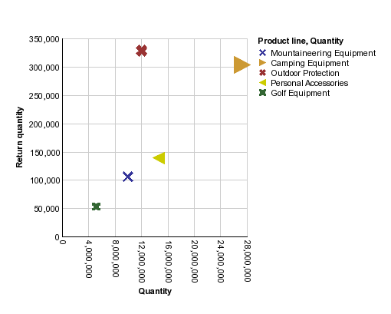
Report Studio
What is Report, Dashboard and Data Module?
A web-based report authoring tool that professional report authors and developers use to build sophisticated, multiple-page, multiple-query reports against multiple databases.

Slide 5
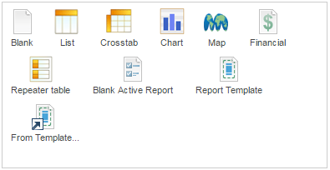
Report Studio
Report Studio enables report authors to create, edit, and distribute a wide range of professional reports..
The different types of reports can be
Lists
Crosstabs
Charts
Maps
Active Reports
There can be a mix of the above reports as well having following properties as well
Multi-Frame
Drill up/down, through
Freeform Layout
Multi-Page
Notes:
5
5
Report designing consists of various components
You use different report types to look at data in different ways or to answer different business questions. For example, you create a list report to show your entire customer base, but you create a crosstab report to show which sales representative has the highest sales for each product line.You can create a chart to present data graphically, and use a repeater to create mailing labels.
In Report Studio, you can create the following types of reports:
( list , crosstab, chart, map, repeater)‏
You can also combine one or more of these in a single report.
We would look into detail of all these report studio components in preceding slide. Cognos 10 has added features which enhances our reporting skills. With the addition of option of multi-frame, multi-page and freeform layout lots of reporting requirements are meet. Drill thru and Drill up/down have enhanced the capabilities of report . We would looking into these thing in the preceding slides.

Slide 6
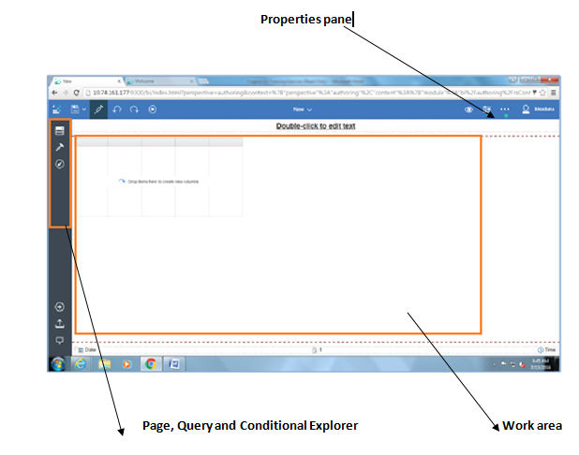
Report Studio (contd…)
Work Area
Notes:
6
6
Let us understand the User Interface of Report studio (Pop up Object 1.1)‏
The Report Studio user interface has two panes, an explorer bar, and a work area to help you create reports.
1) Insertable Objects Pane ( Pop up object 1.2 a , 1.2 b and 1.2 c)‏
The Insertable Objects pane contains objects that you can add to a report. You add objects to a report by dragging them to the work area.
The Insertable Objects pane contains these tabs:
a) The source tab contains items from the package selected for the report, such as data items and calculations.
b) The data items tab describes the queries created in the report.
c) The toolbox tab contains a variety of objects that you can add to the report, such as text and graphics
2) Properties Pane (pop up object 1.6)‏
The Properties pane lists the properties that you can set for an object in a report. You can obtain additional information about a property by selecting it and clicking F1. For example, you can view the list of objects that uses each property. When you specify a value for a property, press Enter, click another property, or save the report to ensure that the value is saved.
3) Explorer Bar ( Pop up object 1.3 followed by 1.4 and 1.5)‏
a) Page explorer button to go to a specific report page or prompt page.
b) Query explorer button to work with queries You use Query Explorer to create or modify queries and to perform complex tasks, such as defining union joins and writing SQL statements
c) Condition explorer button to work with variables. You use variables to define conditions in a report.
4) Work Area
The work area is where you design reports.

Slide 7
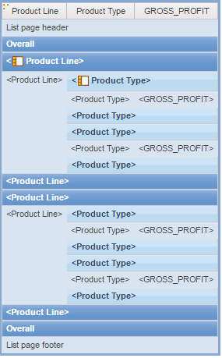
Report Studio (contd…)
A List report displays detailed information in rows and columns.
The layout options available in a List report are as follows:
Headers and footers
List header
Once for each occurrence of the list
Overall header
Once for the entire list
Group header(s)‏
Group footer(s)‏
Overall footer
List footer
List Column Body
List Column Body
Notes:
7
7
List is the most basic thing of Report studio .
A list report is a report that shows data in rows and columns. Each column shows all the values for a data item in the database or a calculation based on data items in the database.
Lets understand the various list components one by one.
List
A layout object that is used to present query results in a list fashion
List Cell
A cell in a row, you can use for a list header or footer.
List Column
A column in a list. Generally, the column will contain a query item, but it may also contain any number of layout objects. For example, the To column in a statement list may present the address in a table format. If the column only contains a query items, then the column will automatically span the group if the query item is grouped.
List Column Body
The contents of a column in a list report.
List Columns
A set of columns in a list.
List Column Title
The title of a list column.
List Footer
The footer that appears at the end of a list on each page on which the list is rendered. It is useful for presenting page totals.
List Header
The header that appears at the start of a list on each page that the list is rendered. It is useful for presenting carry forward totals.
List Page Footer
The footer that appears at the bottom of every page of a list report. This object is rendered after the list details and other list footers.
List Page Header
The header in the list that will appear on every page rendered. It occurs after the column titles and before the overall group header of the list.
List Row
row in a list.

Slide 8
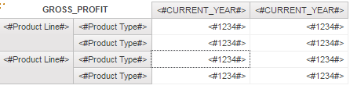
Report Studio (contd…)
Crosstab Reports
Crosstab reports display information in a compact form than a grouped list.
Crosstabs are composed of edges
Row edge defines the members listed on the left side of the crosstab
Column edge defines the members listed at the top of the crosstab
Cells contain the measure values
Edges are composed of the following:
Crosstab Node - A collection of Node Members and Nested Nodes
Crosstab Node Member – A collection of data items that define members
Measures are also valid parts of an edge. Measures are the items that can be counted also called facts, metrics, or key figures.
Sales dollars, quantities and inventory levels are all examples of measures.
Notes:
8
8
What are Cross tab and when do we use them ? (Pop up 3.1)‏
We use crosstab reports to show information in a more compact form than in a grouped list. For example, create a crosstab report to show total sales by product line generated by each sales representative.
Like list reports, crosstab reports are reports that show data in rows and columns. However, the values at the intersection points of rows and columns show summarized information rather than detailed information.
What are Crosstab Nodes and Crosstab Node Members ?
When you add data items to crosstabs, you create crosstab nodes and crosstab node members. These objects allow you to easily create crosstabs, using drag-and-drop operations.
Crosstabs are dimensional objects that have row edges and column edges. Each edge is composed of a set of crosstab nodes. Each crosstab node contains the following:
1) One or more crosstab node members.
2) Zero or one nested crosstab node, which contains one or more crosstab node members or nested crosstab nodes.
Each crosstab node member refers to a data item that contains an expression that defines the members that appear in the crosstab. ( Pop up object 3.2)‏

Slide 9
Report Studio (contd…)
Charts
Charts are a visual representation of data which represents trends, tabular numeric data and other functions that cannot be displayed in tabular reports.
Access information in a report by creating a drill up or down or drill through from elements in a chart.
Charts can be enhanced by applying informational overlays such as baselines, markers and notes.
Maps
Use Map Manager to design your own maps.
Maps are defined by layers:
Region
Color code areas on the map to compare values such as World, Country or State
Point
Color or size to map to compare values for cities, plants, sale districts
Display
Display additional map details to provide context to the reader such as grids and/or an ocean Maps
Notes:
9
9
You can use Report Studio to create many chart types, including column, bar, area, and line charts. ( Pop up object 5.1 and follow it with object 5.2)‏
To create charts, you drag items from the Insertable Objects pane to the following drop zones:
1) measures
2) columns, bars, lines, areas, or points to represent data series
groups, clusters, or stacks to represent categories of related data series
(Pop up Object 6.1 followed till 6.12)‏

Slide 10
Report Studio (contd…)
Filters
Filter expressions enables to view only the selected information of a report and minimizes processing time by excluding unwanted data.
The following are the types of filters:
Detail filters
Summary filters
Slicers
In a crosstab, a slicer is a filter that is applied to the cells of the crosstab, but not the rows or columns.
A slicer is a set of slicer member sets. Each slicer member set is an expression that returns a set of members from the same dimension.
Multiple slicer member sets cannot be created against the same dimension.
a child member of a report item can be added as a slicer.
Notes:
10
10
What are filters and what are they used for?
You add a filter expression to focus a report and minimize processing time by excluding unwanted data. For example, you can filter data to show customers who placed purchase orders valued at over one thousand dollars during the past year. When you run the report, you see only the filtered data.
If an expression is used in multiple reports, or by different report authors, ask your modeler to create the expression as a standalone object in the model and include it in the relevant package
What is a Detail Filter?
A set of conditions in a query that narrow the scope of the data returned. A detail filter is applied before aggregation is complete.
What is Summary filter?
A set of conditions in a query that narrow the scope of the data returned. A summary filter is applied after aggregation is complete.
What is a Slicer ? What is used for?
You use slicers to create dimensional filters that reduce the data included in measure rollups. For example, a slicer is a filter that is applied to the cells but not the rows or columns in a crosstab.
A slicer member set is an expression that returns a set of members from the same dimension. You
can create multiple slicer member sets to filter across two or more dimensions. You cannot create
multiple slicer member sets against the same dimension.
You can add a child member of a report item as a slicer.
For example, you create a crosstab with Product line as rows, Year as columns, and Revenue as the measure. You drag Sleeping Bags to the Slicer pane. When you run the report, all product lines appear in the crosstab, but a value appears only for the Camping Equipment row because Sleeping Bags is a child of Camping Equipment

Slide 11
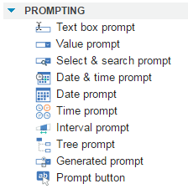
Report Studio (contd…)
Prompts
Prompts act as questions for specific areas of business that narrow the result set, making the report more manageable.
Prompts can come in many styles such as text box prompts, value prompts, search and select prompts, and date prompts.
The following are the features of prompts:
Used for parameters in filters and calculations
Optional and required
Set Single and multiple values in Prompt properties
Multilingual Prompts can be used
Report Studio will default prompt type
Types of Prompts
Notes:
11
11
You can add prompts to a report to add interactivity for users.
Prompts act as questions that help users to customize the information in a report to suit their own needs.
For example, you create a prompt so that users can select a product type. Only products belonging to the
selected product type are retrieved and shown in the report.
Prompts are composed of three interrelated components. Parameters, which are based on parameterized filters, form the questions you want to ask users.
Prompt controls provide the user interface in which the questions are asked. Finally, parameter values provide the answers to the questions.
Report Studio provides several ways to create prompts. You can
use the Build Prompt Page tool
build your own prompt and prompt page
create a parameter to produce a prompt
insert prompts directly into the report page
Features of prompts are
1) You can use parameters in filters and calculations
2) You can set the usage of the prompt that you have created as Optional and required
3) You can set Single and multiple values selection in the prompt property
4) Multilingual prompts can also be used in the reports
5) Report Studio will default prompt type that is set while creating a report.

Slide 12
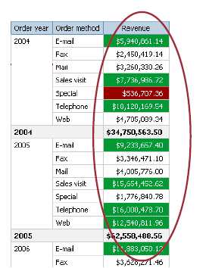
Report Studio (contd…)
Conditional Processing
Conditional styles enable the user to establish criteria on which Report Studio highlights specified ranges or values.
Conditional styles can be used with numeric data, text data, and date values.
Conditional highlighting based on variables
Conditional text based on multilingual variables
Conditional Blocks
Conditional Rendering:
Object not rendered based on variable
as if the object does not exist (versus exists but transparent or hidden)‏
Useful to hide a column in a list
Supported on:
Block, Text item, List, List column, Crosstab, Chart, Table, Repeater, Repeater Table, Repeater Table Cell, image, hyperlink, hyperlink button, prompts, HTML item, field set, and so on.
Notes:
12
12
You can define conditions to control what users see when they run a report. Conditions can apply to specific items in a report. For example, you can define a conditional style variable to highlight exceptional data, such as product revenue that exceeds your target.
Conditions can also apply at the report layout level. Conditional layouts are useful for delivering reports to a multilingual audience. For example, you can have text items, such as titles and cover pages, appear in the same language as the data in the report.
You can also use conditional formatting to highlight exceptional data in a report. All conditional processing is based on report variables. There are three types of report variables:
string, boolean, and report language.
What is Conditional Rendering?
You add conditional rendering to specify which objects are rendered when a report is run. This is useful when your report contains sensitive data.
Conditional rendering is not the same as showing or hiding objects. When you hide an object, the object exists but is transparent. If an object is not rendered, it is not in the report.
You can apply this conditioning on the listed items.

Slide 13
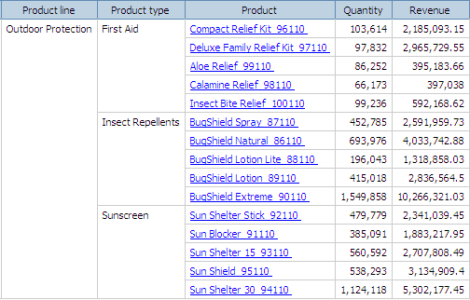
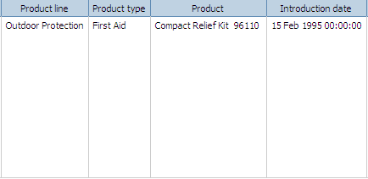
Drill Through
Report Analytics allows you to drill through from one report to another report that contains related information.
To create a drill through, you must have a Parent (Source) report and a Target (Child) report.
Notes:
SC, VCR
Examples of bullet point items:
Examine how to change properties.
Modify a document.
Distribute your findings.
Ensure that slide titles are not the same for more than 2 slides in a row. The second occurrence of the same slide title must include (cont’d).
Standard Classroom
First level bullet standards: all sentences are bulleted, even standalone sentences. Sentences should be full sentences complete with punctuation.
Second level bullet standards: items do not have to be complete sentences, however end punctuation should be consistent among all second level items on the same slide.
Virtual Classroom Recording
Bullet points do not have to be complete sentences for VCR. If bullet points are not complete sentences, do not capitalize the first word and do not add end punctuation.
Recommended VC Script:
<Topic discussion of your choice. Less than 5 minutes of discussion per slide is highly recommended.>

Slide 14
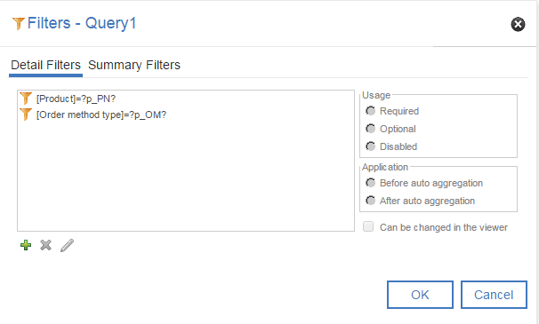
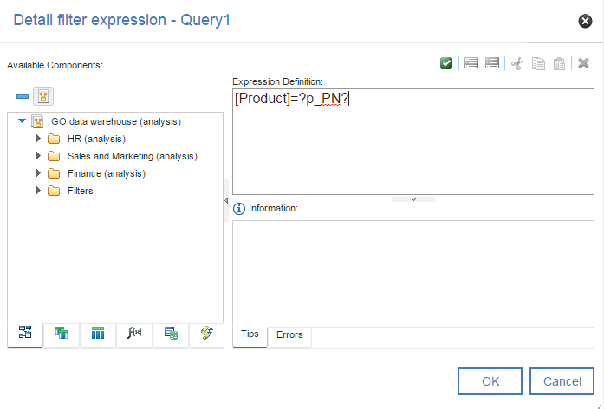
Drill Through – Target Report
First create the Target report.
In the Target report, create a filter with a parameter that relates to a column in the Source report.
Notes:
SC, VCR
Examples of bullet point items:
Examine how to change properties.
Modify a document.
Distribute your findings.
Ensure that slide titles are not the same for more than 2 slides in a row. The second occurrence of the same slide title must include (cont’d).
Standard Classroom
First level bullet standards: all sentences are bulleted, even standalone sentences. Sentences should be full sentences complete with punctuation.
Second level bullet standards: items do not have to be complete sentences, however end punctuation should be consistent among all second level items on the same slide.
Virtual Classroom Recording
Bullet points do not have to be complete sentences for VCR. If bullet points are not complete sentences, do not capitalize the first word and do not add end punctuation.
Recommended VC Script:
<Topic discussion of your choice. Less than 5 minutes of discussion per slide is highly recommended.>

Slide 15
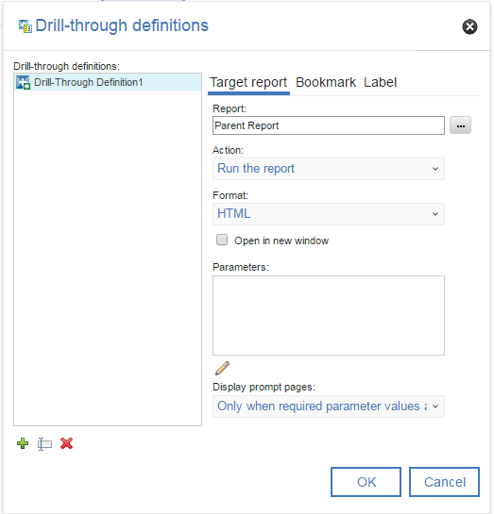
Drill Through – Source Report
Next, create the Source report with a drill through.
The Source report will provide a column that will drill through to the Target report.
Notes:
SC, VCR
Examples of bullet point items:
Examine how to change properties.
Modify a document.
Distribute your findings.
Ensure that slide titles are not the same for more than 2 slides in a row. The second occurrence of the same slide title must include (cont’d).
Standard Classroom
First level bullet standards: all sentences are bulleted, even standalone sentences. Sentences should be full sentences complete with punctuation.
Second level bullet standards: items do not have to be complete sentences, however end punctuation should be consistent among all second level items on the same slide.
Virtual Classroom Recording
Bullet points do not have to be complete sentences for VCR. If bullet points are not complete sentences, do not capitalize the first word and do not add end punctuation.
Recommended VC Script:
<Topic discussion of your choice. Less than 5 minutes of discussion per slide is highly recommended.>

Slide 16
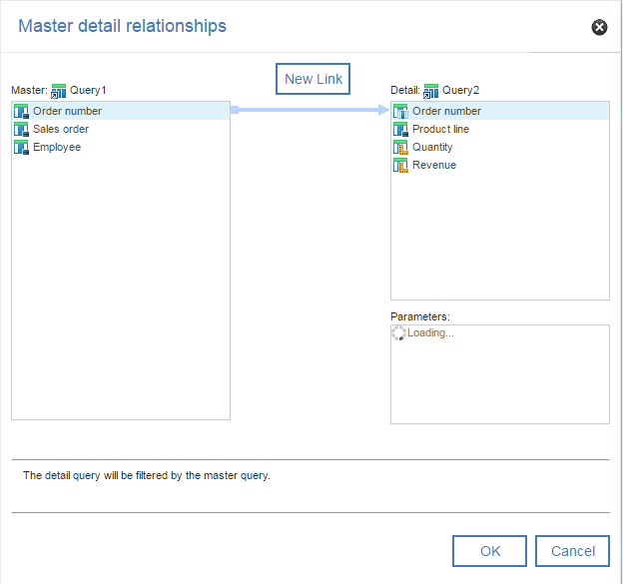
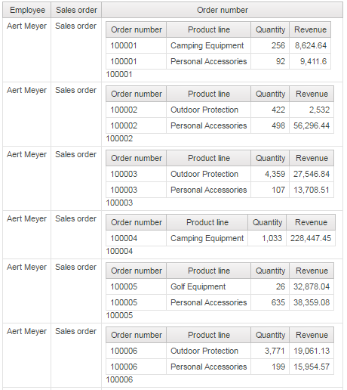
Master Details report
Report Analytics allows you to summary and detail level information in the same report
For example, to create a Master detail you must have a summary and detail list reports and we need to define the relationship b/w two lists.
Notes:
SC, VCR
Examples of bullet point items:
Examine how to change properties.
Modify a document.
Distribute your findings.
Ensure that slide titles are not the same for more than 2 slides in a row. The second occurrence of the same slide title must include (cont’d).
Standard Classroom
First level bullet standards: all sentences are bulleted, even standalone sentences. Sentences should be full sentences complete with punctuation.
Second level bullet standards: items do not have to be complete sentences, however end punctuation should be consistent among all second level items on the same slide.
Virtual Classroom Recording
Bullet points do not have to be complete sentences for VCR. If bullet points are not complete sentences, do not capitalize the first word and do not add end punctuation.
Recommended VC Script:
<Topic discussion of your choice. Less than 5 minutes of discussion per slide is highly recommended.>

Slide 17
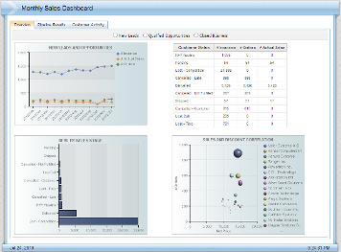
Report Studio (contd…)
Cognos Active Reports
IBM Cognos Active Reports are interactive, intuitive, stand-alone reports with the ability to be highly formatted.
An Active Reports profile in Report Studio allows developers to create these sophisticated report applications.
Key Capabilities
Richer set of controls for experienced Professional Report Authors to build interactive
dashboards for the business
Saved MHT applications allow for fast consumption and offline consumption
Schedule and burst applications to broad and diverse users
Benefits
Improved time-to-decision through a more interactive and richer user experience
Improved user satisfaction through performance improvements gained through a saved MHT output
Improved productivity by being able to work while not being physically “connected” to reporting application

Slide 18
Report Studio (contd…)
Interactive Behavior
Left side - Does this control set a variable value?
Right side - Does this control react to a variable being set? (usually by another control)
To see both sides of a connection select the controls from the drop down list
This control’s reaction to variables being set
Variables set
by this control

Slide 19
Q & A

Slide 20
Thank You
Review Date | 14-July-2016
Version | 1.0
Next Review Due | 14-July-2017

